Slide 1


Chapter 8: Cognition
& Intelligence
PSY 101
Notes:
The background image is in the public domain. https://www.rawpixel.com/image/2478175/free-illustration-image-vintage-pattern-wallpaper

Slide 2
OVERVIEW
Language
  learning & acquisition
  bilingualism & sign language
  cultural differences
Problem solving
  barriers to problem solving
  different approaches
Decision making
  heuristics
  flaws in reasoning
Intelligence
  what do IQ scores mean?
  nature vs. nurture
  cultural differences

Slide 3
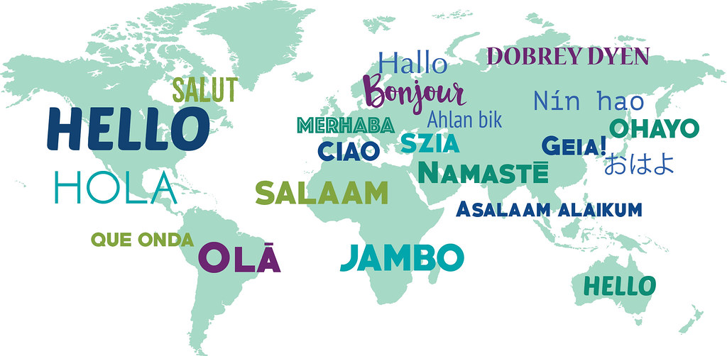
Part 1: Language
Hello © Emma Howard at Dentably Magazine, CC BY 2.0
PSY 101

Slide 4
LANGUAGE
Definition: a system to turn thoughts into meaningful communication
Language evolved about 100,000 years ago
Fun fact: this text is a language!

Slide 5
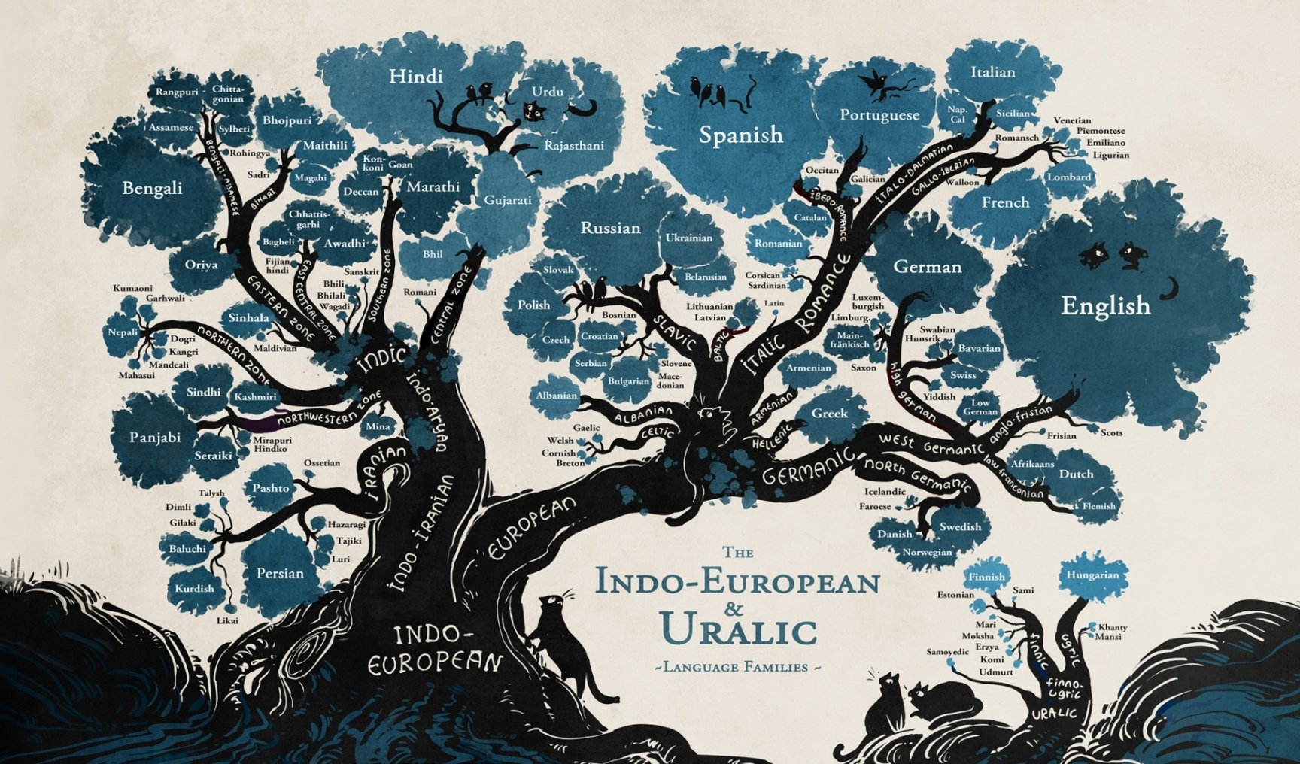
LANGUAGE WORLDWIDE
There are between 6,900 and 7,100 languages spoken worldwide.
  22% of languages
  have fewer than 1,000 speakers!
  23 languages = half the world’s population
Language Tree © Minna Sundberg at SSSS Comic, CC BY-NC-SA 2.0

Slide 6
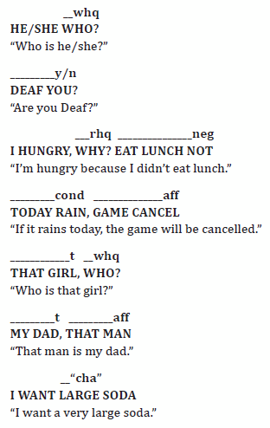
← non-manual element
← hand signs
← actual meaning
SIGN LANGUAGE
Definition: full languages which communicate through
  manual elements (hands)
  non-manual elements (facial expressions, etc.)
Have their own unique grammar →
Examples of Non Manual Markers in Glossing © StartASL

Slide 7
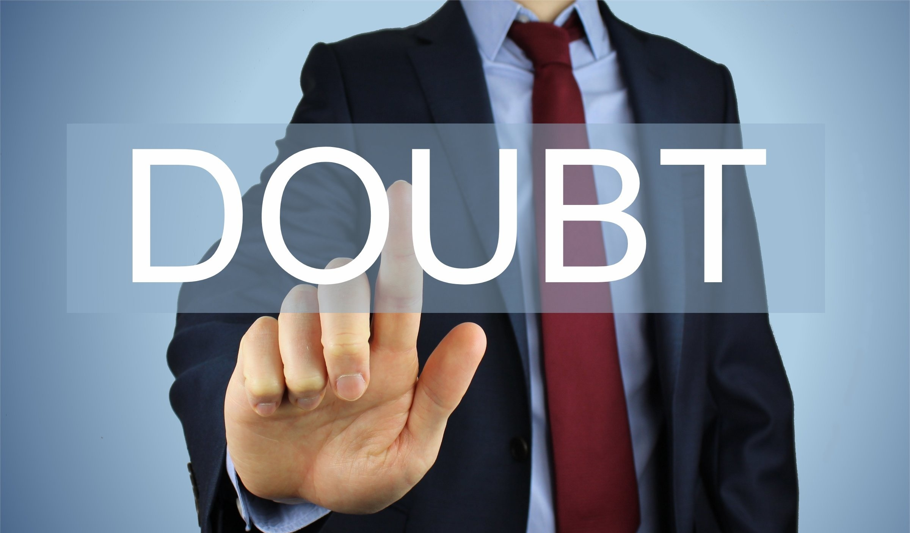
LANGUAGE ACQUISITION 1
Definition: the process by which humans figure out how to understand and create language
Behaviorist theory of language (1957): B.F. Skinner says parents “reinforce” vocalizations as they “start to sound like words”
  i.e., language is learned
  only through nurturing and
  rote memorization…
Doubt © Nick Youngson, CC BY-SA 3.0

Slide 8
LANGUAGE ACQUISITION 2
Nativist theory of language (1959): Noam Chomsky (founder of modern linguistics) reasonably critiques B.F. Skinner, then theorizes kids have a “native” (i.e., innate) ability to learn language
  Language acquisition device: an innate mental mechanism or process that facilitates the learning of language

Slide 9

LANGUAGE ACQUISITION 3
Our modern understanding of language acquisition is sociocultural, combining elements of Skinner’s and Chomsky’s theories
Interactionist theory of language: human excel at learning language until age 5 (nature), but we need social interactions to do so (nurture)
Brunette Mother Posing with Baby in Hands © Toàn Văn

Slide 10
LANGUAGE ACQUISITION 4
Critical period hypothesis: language acquisition is only possible up to age 5, during the “critical period” when there’s sufficient neuroplasticity
Language deprivation: when someone isn’t taught language by that age and can never learn to speak
  Generally happens because a child doesn’t have human contact at an early age; sometimes called “feral children”
  Can happen to deaf children who aren’t taught a sign language

Slide 11

LANGUAGE
ACQUISITION 5
A famous example of a “feral child” is Genie Wiley, an American girl who was neglected until she was 13.
PBS NOVA has a 1994 documentary on efforts to teach her language:
  https://archive.org/details/SecretoftheWildChild

Slide 12
BILINGUALISM
Definition: knowing 2+ separate languages
Controversies →
  Does bilingualism slow down language development?
    No!
  Does bilingualism affect cognitive processes and skills?
    Sometimes.
    Language processing is slower, but attention, working memory capacity, AND abstract reasoning are better.

Slide 13
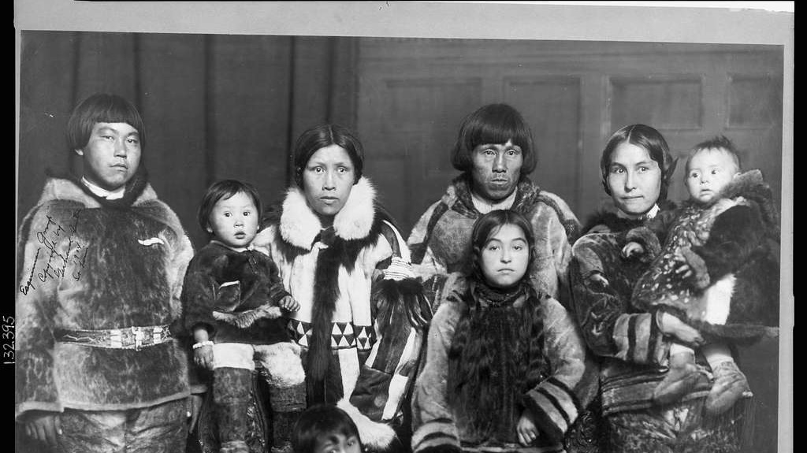
CULTURE & LANGUAGE 1
Does language determine what thought looks like?
  Or does thought determine what language looks like?
Linguistic relativity: the idea that your language determines how you think about things
  AKA the Sapir-Whorf hypothesis
  Fact Check: “Eskimo-Aleut languages have 1,000 words for snow” is a false and exaggerated version of this hypothesis
Notes:
The background image is in the public domain. https://picryl.com/media/esquimaux-group

Slide 14
CULTURE & LANGUAGE 2
Code switching: the practice of switching between multiple languages/dialects depending on the context
  Basic example = speaking English at school and Spanish at home
    But this can be a lot more specific, like what slang you use
    You’re probably not going to say “eepy” or “sus” during a job interview
  Many minority groups feel like they’re required to code switch to be taken seriously in academic/professional settings

Slide 15
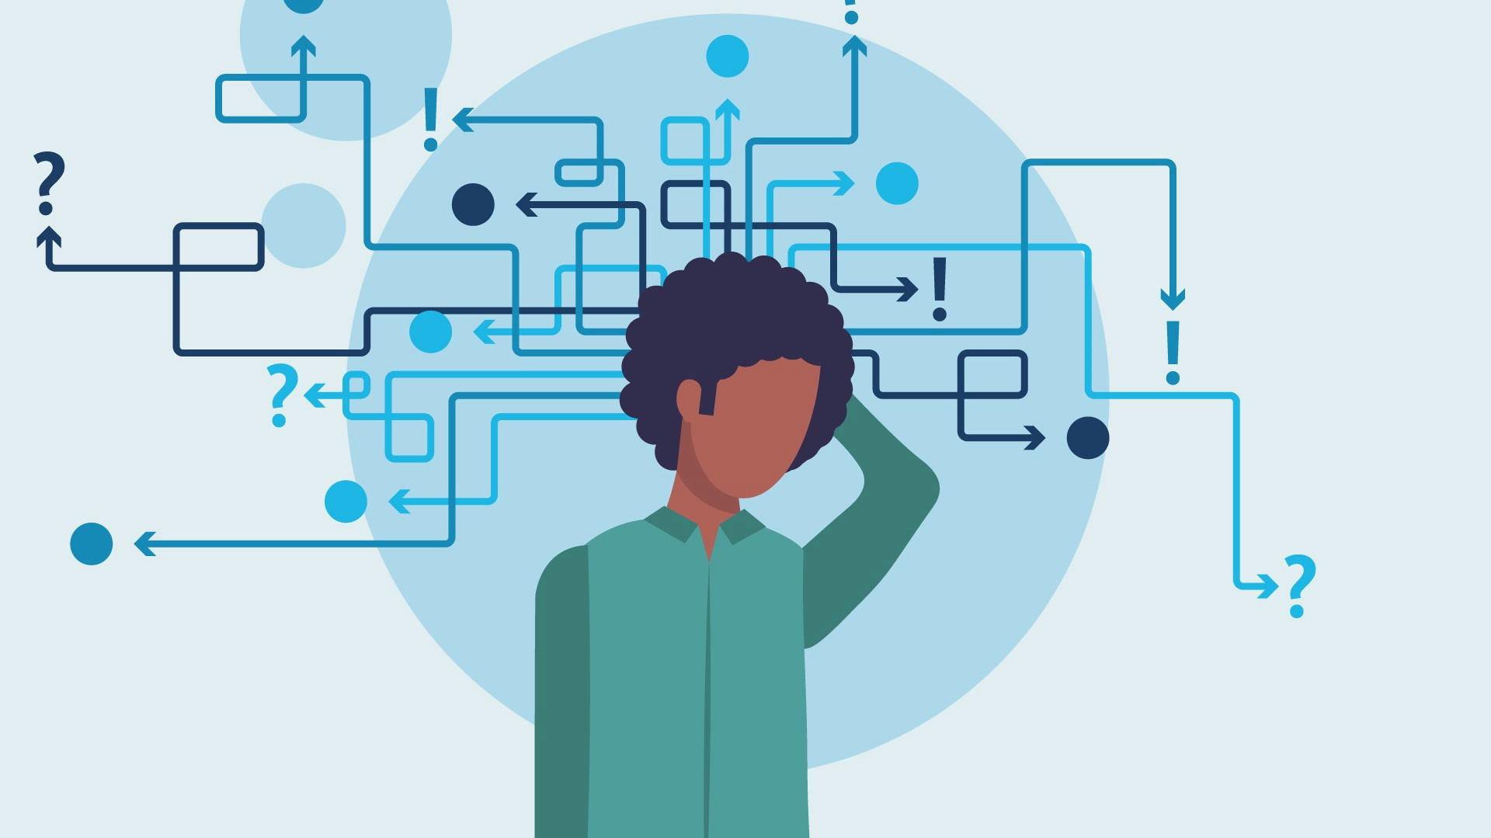
Part 2: Problem solving &
Decision Making
Problem Solving Illustration © digits.co.uk, CC BY 2.0
PSY 101

Slide 16
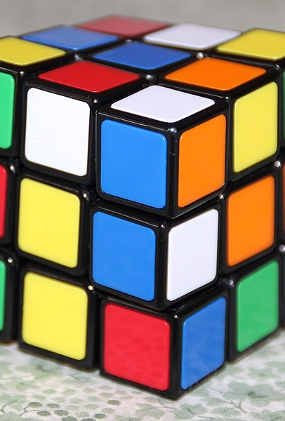
BARRIERS TO EFFECTIVE PROBLEM SOLVING
Mental set: when you can only think of strategies that have worked in the past
Irrelevant information distracting you
Unnecessary constraints leading you astray (see next slide)
Functional fixedness: when you can only think of common uses for an item
Rubik’s Cube 3x3 © Thenror, CC BY-SA 4.0

Slide 17

PROBLEM SOLVING EXAMPLE
A man dressed in all black is walking down a dirt road. Suddenly, an SUV with no lights on comes around the corner and screeches to a halt. How did the car’s driver know he was there?
participation

Slide 18
PROBLEM SOLVING SOLUTION
A man dressed in all black is walking down a dirt road. Suddenly, an SUV with no lights on comes around the corner and screeches to a halt. How did the car’s driver know he was there?
Answer: It’s daytime! The question is phrased in such a way to provide distracting details (irrelevant information) that encourage unnecessary restraints on thinking.

Slide 19
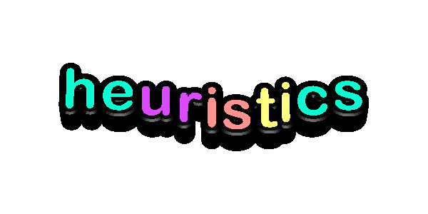
OKAY, BUT…
Why does someone have to tell us the answer to trick questions like these? Why can’t we figure it out on our own?
It’s because of…

Slide 20
HEURISTICS
Definition: cognitive shortcuts or frameworks we use to solve problems or make decisions
  mental set and functional fixedness are heuristics – 95% of the time, they help us save on cognitive resources
  the rest of the time, they accidentally limit our brains
  Fun fact: the theory that we use heuristics to save mental energy is called cognitive laziness.

Slide 21
APPROACHES TO PROBLEM SOLVING
Besides heuristics, you can try…
2. Trial & error: just keep incrementally guessing!
Create sub-goals or intermediate steps in the problem (i.e., divide and conquer)
Use analogies: look for answers that solved similar problems
Engage in lateral thinking and change your representation or perspective of the problem
Take a break! Incubation effect: when new solutions emerge for a previously unsolved problem after a period of ignoring the problem
  This happens because your subconscious keeps trying solutions while the rest of your brain is distracted

Slide 22
FLAWS IN REASONING
Any heuristic we use can lead us to make incorrect assumptions
  This is why humans are naturally bad at applying statistics in real world situations!

Slide 23

FLAWS IN REASONING EXAMPLE 1
Example: Which dots are more randomly distributed?
  Answer as quickly as possible!
Solution: the left image is truly random; the dots in the right image are too evenly spaced to be random.
Clustering illusion: thinking that clusters in random distributions aren’t random
  This is why humans created constellations!

Slide 24
FLAWS IN REASONING EXAMPLE 2
  Do more words start with K vs. or have K as the third letter?
    Availability heuristic: relying on examples that come to mind more easily
    It’s easier to think of words starting with K, so we assume more words start with K
  Another example: What percentage of people have a DUI?
    Your answer will vary significantly depending on whether you personally know anyone with a DUI, you’ve heard about DUIs in the news recently, etc.
    Not-so-fun fact: The answer is just over 2% of American drivers – so 1 in 50 people.

Slide 25
FLAWS IN REASONING EXAMPLE 3
  Sarah reads her horoscope everyday, loves aromatherapy, and attends a local spiritual group. Is she more likely to be a school teacher or a holistic healer?
  Representativeness heuristic: assuming events or relationships that seem more representative must be true
  We also ignore the actual number of teachers and holistic healers when assessing Sarah (these “actual numbers” are called base rates)
    There are many more teachers than holistic healers, so statistically, she’s probably a teacher

Slide 26
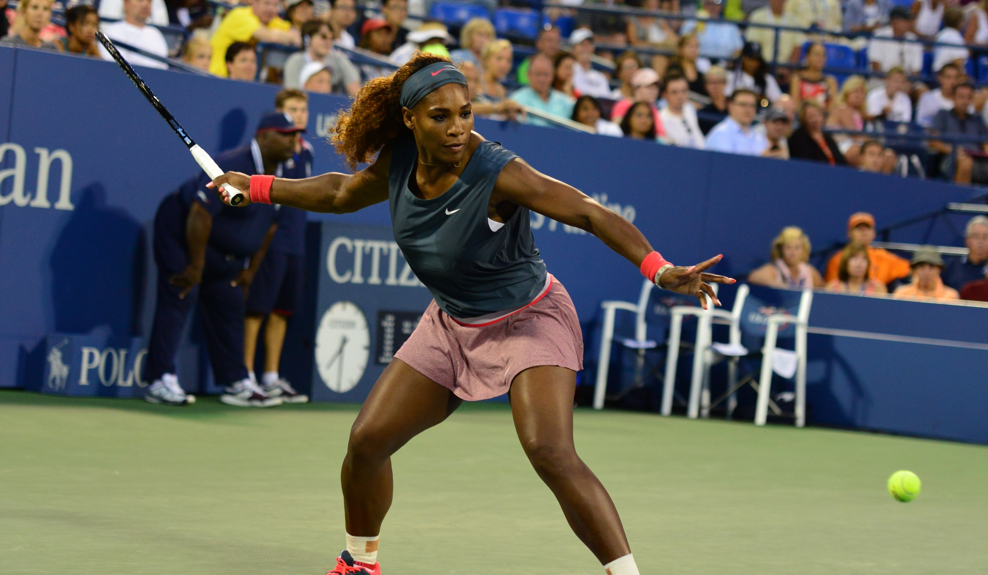
FLAWS IN REASONING EXAMPLE 4
The 2018 Wimbledon Tennis Championships semifinal bracket consisted of Jeļena Ostapenko, Angelique Kerber, Serena Williams, and Julia Görges.
  Without looking it up,
  who do you think won?
  Recognition heuristic: when
  choosing between multiple options, you place a higher value on choices you recognize… like Serena Williams!
US Open 2013 Part 2 615 © Edwin Martinez, CC BY 2.0
Notes:
It was Angelique Kerber ‘s first (and so far only) Wimbledon win, vs. Serena’s 7.

Slide 27
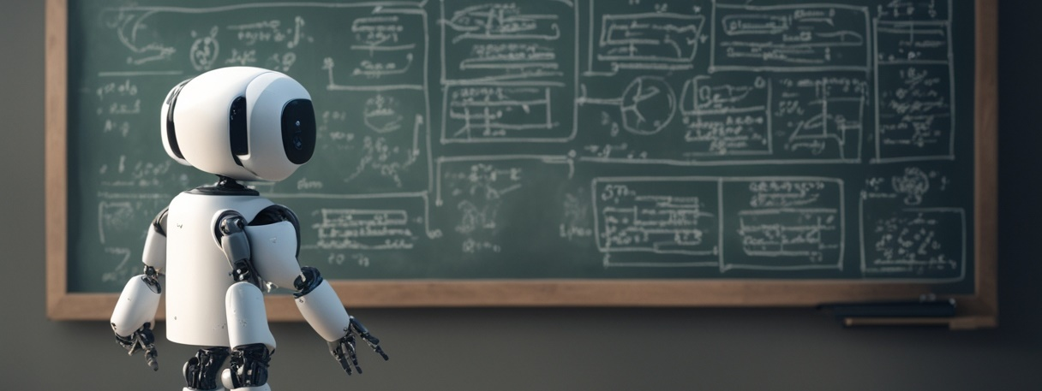
PART 3: INTELLIGENCE
participation
PSY 101
Notes:
Participation prompt: What’s wrong with this image? (The robot has three arms, the robot’s fingers look strange, the bottom edge of the blackboard jumps around, etc.)
This image was generated by AI. https://deepai.org/gallery-item/c06958f7b6834e9fb64ce6c620cbe736/one-robot-from-behind-looking-at-a-blackboard-covered.jpg.html

Slide 28
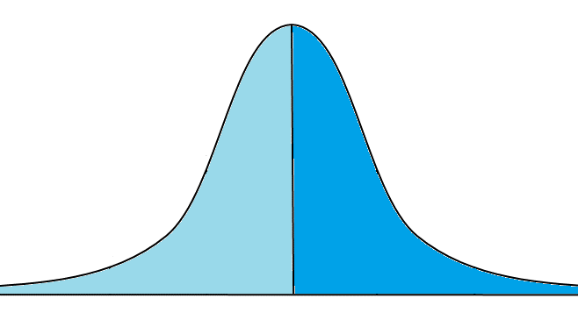
LET’S TALK… STATISTICS! 1
Population mean: the average of everyone’s scores
  For example, American women have a population mean height of 5ft 3.5in
Normal distribution: when scores follow
a symmetrical pattern such that
most people score close to the
population mean
  Also called a Bell curve
Mean
Median
Mode
Symmetry
“Bell Curve”
50%
50%
Adapted from Empirical Rule © Dan Kernler, CC BY-SA 4.0
Notes:
For example the population mean for American women’s height is 5ft and 3.5in!

Slide 29
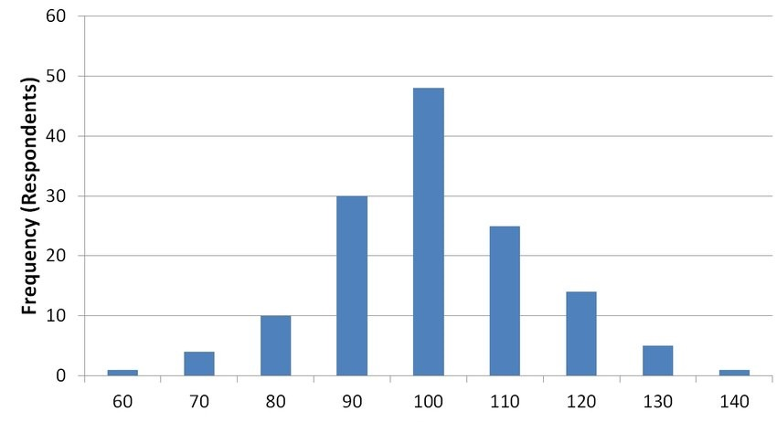
LET’S TALK… STATISTICS! 2
In this normal distribution, the population mean is 100 points; the largest group (48 people) all scored around 100
Mean
Median
Mode
“Bell Curve”
A Normal Distribution
Bundzel, Lacko, Zolotová, Kasanicky, & Zelenka, 2016

Slide 30
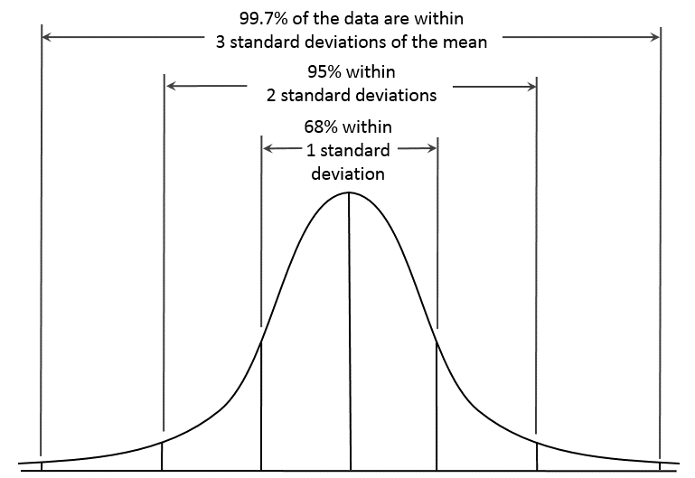
LET’S TALK… STATISTICS! 3
Standard deviation: the average amount that people’s scores are different from the population mean
  68% of people always score within
  “1 standard deviation”
    95% of people always fall within
    2 standard deviations
  The more “standard deviations” a
  score is away from the mean, the
  less likely you are to have that score!
Empirical Rule © Dan Kernler, CC BY-SA 4.0

Slide 31
LET’S TALK… STATISTICS! 4
Bundzel, Lacko, Zolotová, Kasanicky, & Zelenka, 2016
Empirical Rule © Dan Kernler, CC BY-SA 4.0
In this example, 68% of people score between 85 and 115 (1 standard deviation) and 95% of people score between 70 and 130 (2 standard deviations)
Outliers
Notes:
Actual scores could be anything; the population mean could be 10 points, 6 feet, 1 acre, etc.

Slide 32
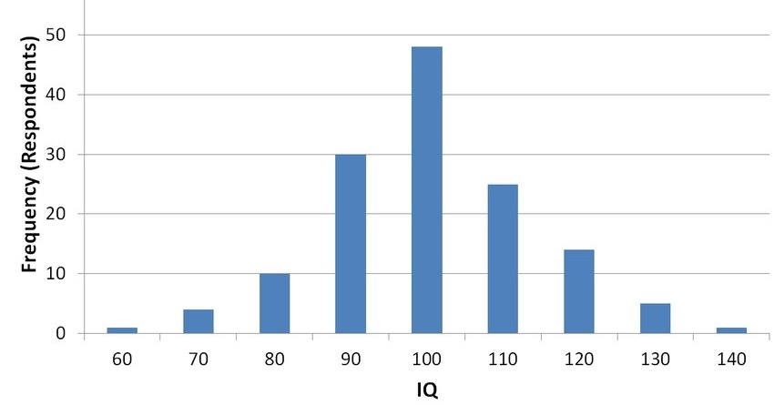
WHAT DO IQ SCORES MEAN? 1
To calculate an intelligence quotient, “raw” scores are changed so everyone’s scores perfectly fit a normal distribution
  This is called standardization
Mean IQ score: always 100
points
  Standard deviation of
  IQ scores: always 15 points
Bundzel, Lacko, Zolotová, Kasanicky, & Zelenka, 2016

Slide 33
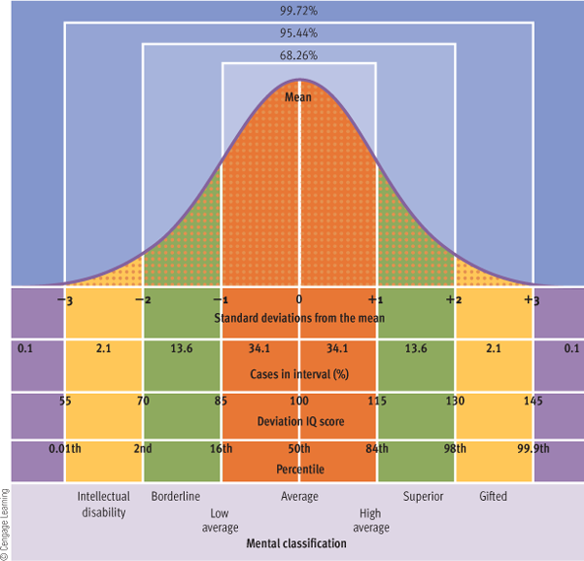
WHAT DO IQ SCORES MEAN? 2
Your IQ score indicates where you fall in the (standardized) normal distribution
  50% of people have a “below average” IQ

Slide 34
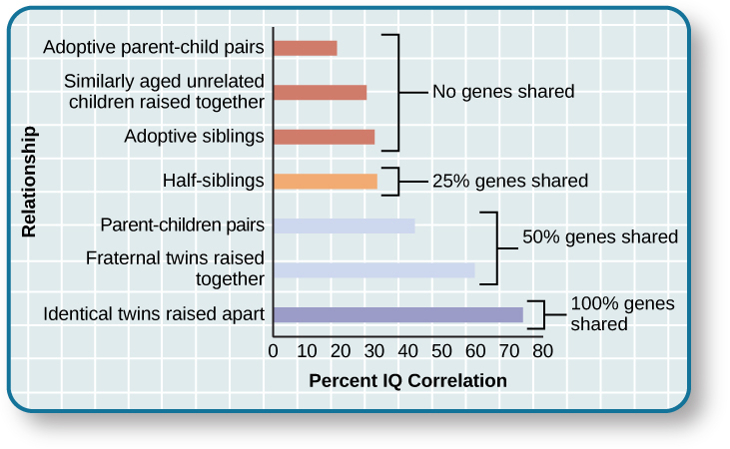
WHAT DETERMINES
IQ? 1
IQ scores are 55-60% genetic
  Identical twins raised apart have IQ scores with a correlation of 0.78
Childhood home is ~10% responsible for IQ scores
  Unrelated children raised together have IQ scores with a correlation of 0.30
IQ scores are 5-10% random The same person taking the IQ test again only has a correlation of 0.95
The Source of Intelligence © OpenStaxCollege, CC BY 4.0

Slide 35
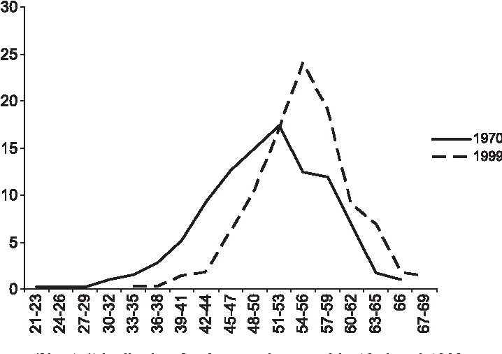
WHAT DETERMINES IQ? 2
Colom, Lluis-Font, & Andrés-Pueyo, 2005
Flynn effect: Industrialized nations show an increase in IQ scores over time
  Why do you think this is?
  We’ve accounted for 75% of the
  variability in IQ scores. What could
  be the other 25%?
% of participants
participation
raw IQ scores

Slide 36
WHAT DETERMINES IQ? 3
Cumulative deprivation hypothesis: children raised in substandard circumstances experience gradual decline in IQ as they grow older
People are more likely to have a lower IQ score if…
    they’re from a low socioeconomic status (SES) background
    they experienced malnutrition as a child
    they have fewer years of education
    they’ve been exposed to lead or other harmful chemicals

Slide 37
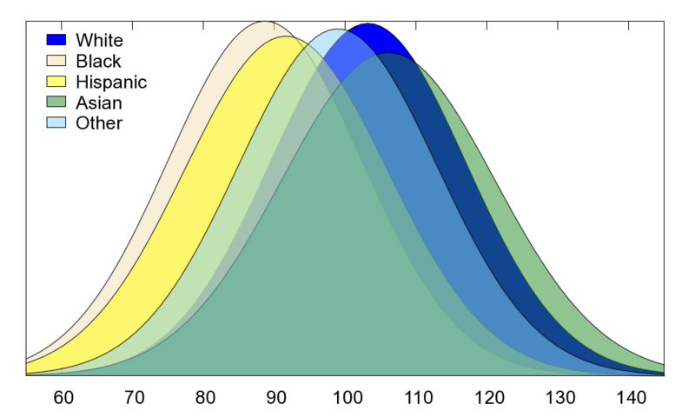
CULTURAL DIFFERENCES IN IQ 1
IQ scores in some minority groups (African American, Native American, Hispanic) are up to 15 points lower on average than in white groups.
Why?
  Heritability: The 1920s argument
    “If IQ scores are mostly genetic, and people of color score worse on an IQ test, they must be genetically less intelligent!”
    Not a logical argument; correlation is not causation
IQ Score
Weiss, Saklofske, Caolson, & Raiford, 2010

Slide 38
CULTURAL DIFFERENCES IN IQ 2
IQ scores in African American, Native American, Hispanic groups are up to 15 points lower than in white groups. Why?
  Environment: These minority groups have, on average, lower SES, which can result in worse education, childhood malnourishment, etc.
    “But what if people of color have a low SES because they have low IQ scores?”
    Systematic economic discrimination: People of color, especially African Americans, were denied well-paying jobs, good housing, etc., which directly resulted in a lower SES

Slide 39
CULTURAL DIFFERENCES IN IQ 3
IQ scores in African American, Native American, Hispanic groups are up to 15 points lower than in white groups. Why?
  When people from minority groups use up cognitive resources worrying about reinforcing stereotypes, AKA stereotype threat
    If you have fewer resources to answer test questions, your test scores are worse
  Intentionally…?

Slide 40
Questions from a WWI era IQ test
Bell Durham is the name of a
  Chewing gum
  Aluminum ware
  Tobacco
  Clothing
Seven-up is played with
  Rackets
  Cards
  Pins
  Dice
The Merino is a kind of
  Horse
  Sheep
  Goat
  Cow
The most prominent industry in Minneapolis is
  Flour
  Packing
  Automobiles
  Brewing
Garnets are usually
  Yellow
  Blue
  Green
  Red
George Ade is famous as a
  Baseball player
  Comic artist
  Actor
  Author
The Orpington is a kind of
  Fowl
  Horse
  Granite
  Cattle
participation
Notes:
https://historymatters.gmu.edu/d/5293

Slide 41
Answers from a WWI era IQ test
Bell Durham is the name of a
  Chewing gum
  Aluminum ware
  Tobacco
  Clothing
Seven-up is played with
  Rackets
  Cards
  Pins
  Dice
The Merino is a kind of
  Horse
  Sheep
  Goat
  Cow
The most prominent industry in Minneapolis is
  Flour
  Packing
  Automobiles
  Brewing
Garnets are usually
  Yellow
  Blue
  Green
  Red
George Ade is famous as a
  Baseball player
  Comic artist
  Actor
  Author
The Orpington is a kind of
  Fowl
  Horse
  Granite
  Cattle
If you didn’t know these, are you unintelligent? Or do IQ tests, perhaps, measure intelligence subjectively?

Slide 42
DO IQ TESTS INTENTIONALLY SCORE MINORITY GROUPS LOWER?
Every iteration of the IQ test was developed by (and standardized on) people who were…
  white
  middle- to upper-class
  American or European
  male
Consequently, IQ tests measure intelligence in those populations
“But how do we know that was intentional?”
  IQ tests were created by eugenicists who already believed minority groups are genetically unintelligent
Not-so-fun fact: The first IQ test was developed by Francis Galton, who was the founder of eugenics
  The subsequent Binet-Simon test was translated into English by H. H. Goddard, a “champion of the eugenics movement”

Slide 43
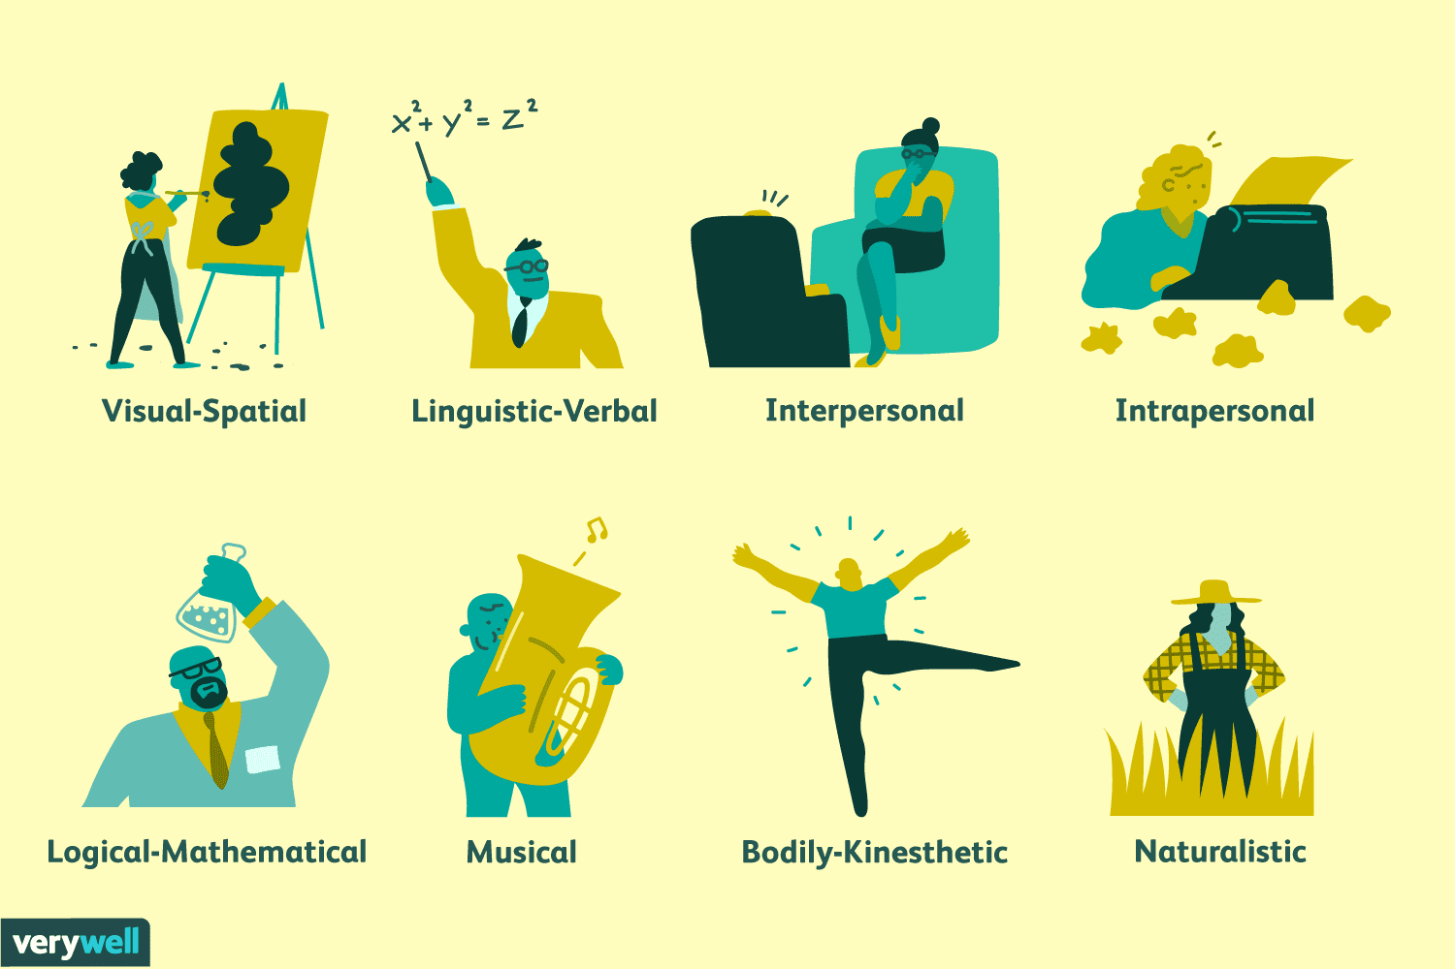
TYPES OF INTELLIGENCE
IQ tests only measure logical, spatial, and linguistic intelligence; they miss out on the other 5 types!
All 8 Types of Intelligence

Slide 44
REVIEW
We probably acquire language through both nature AND nurture
1
Humans are “lazy” problem-solvers (and naturally bad at statistics)
2
IQ scores are alright at measuring intelligence, but they have major flaws
3

